Slide 1
ME759 High Performance Computing for Applications in Engineering [Spring 2020]
Lecture 06
02/03/2019
Dan Negrut, 2020 ME759 UW-Madison

Slide 2
Quote of the day
“I have three kids and no money... Why can't I have no kids and three money?”
-- Homer Simpson, Safety Inspector [1989 - ]

Slide 3
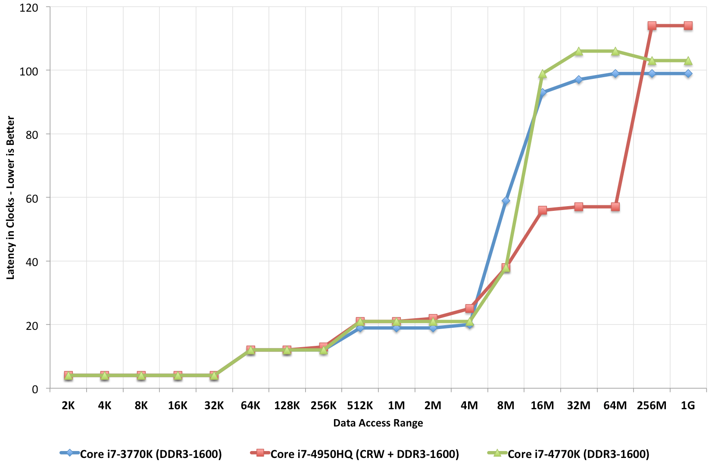
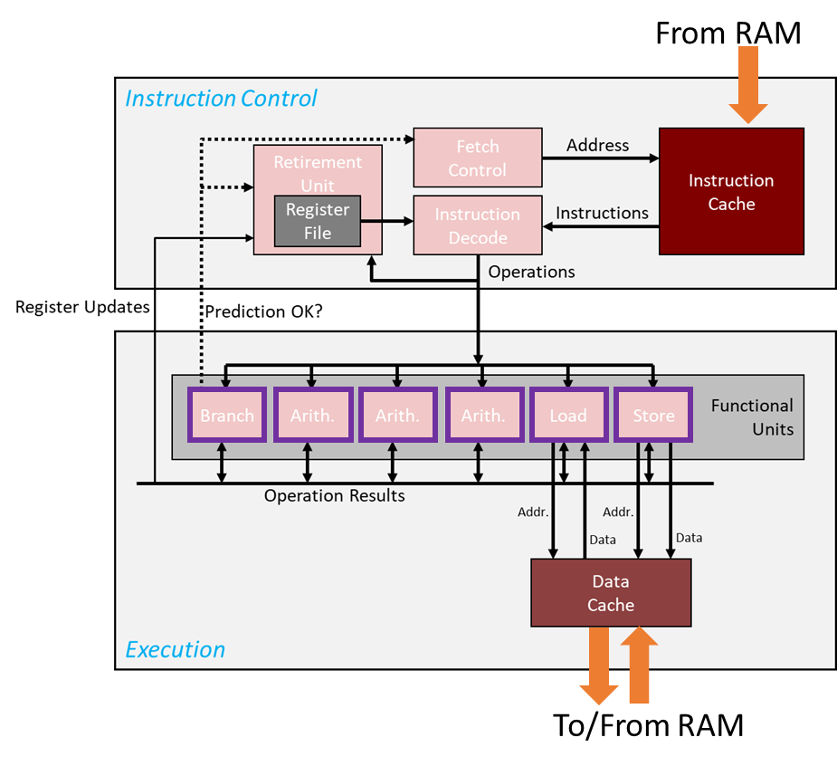
Before we get going…
Last time: Caches
Simple example: 30X speedup
Typically 3 levels of cache
4 cycles (L1), 12 cycles (L2), 20 cycles (L3)
Data from main memory: 100-120 cycles
The anatomy of the cache
Today
The cache: wrap up
The Virtual Memory
Other tidbits:
Please take care of the assigned reading
Assignment due on Th at 9 pm
Use Piazza to get things going (for you or others)

Slide 4
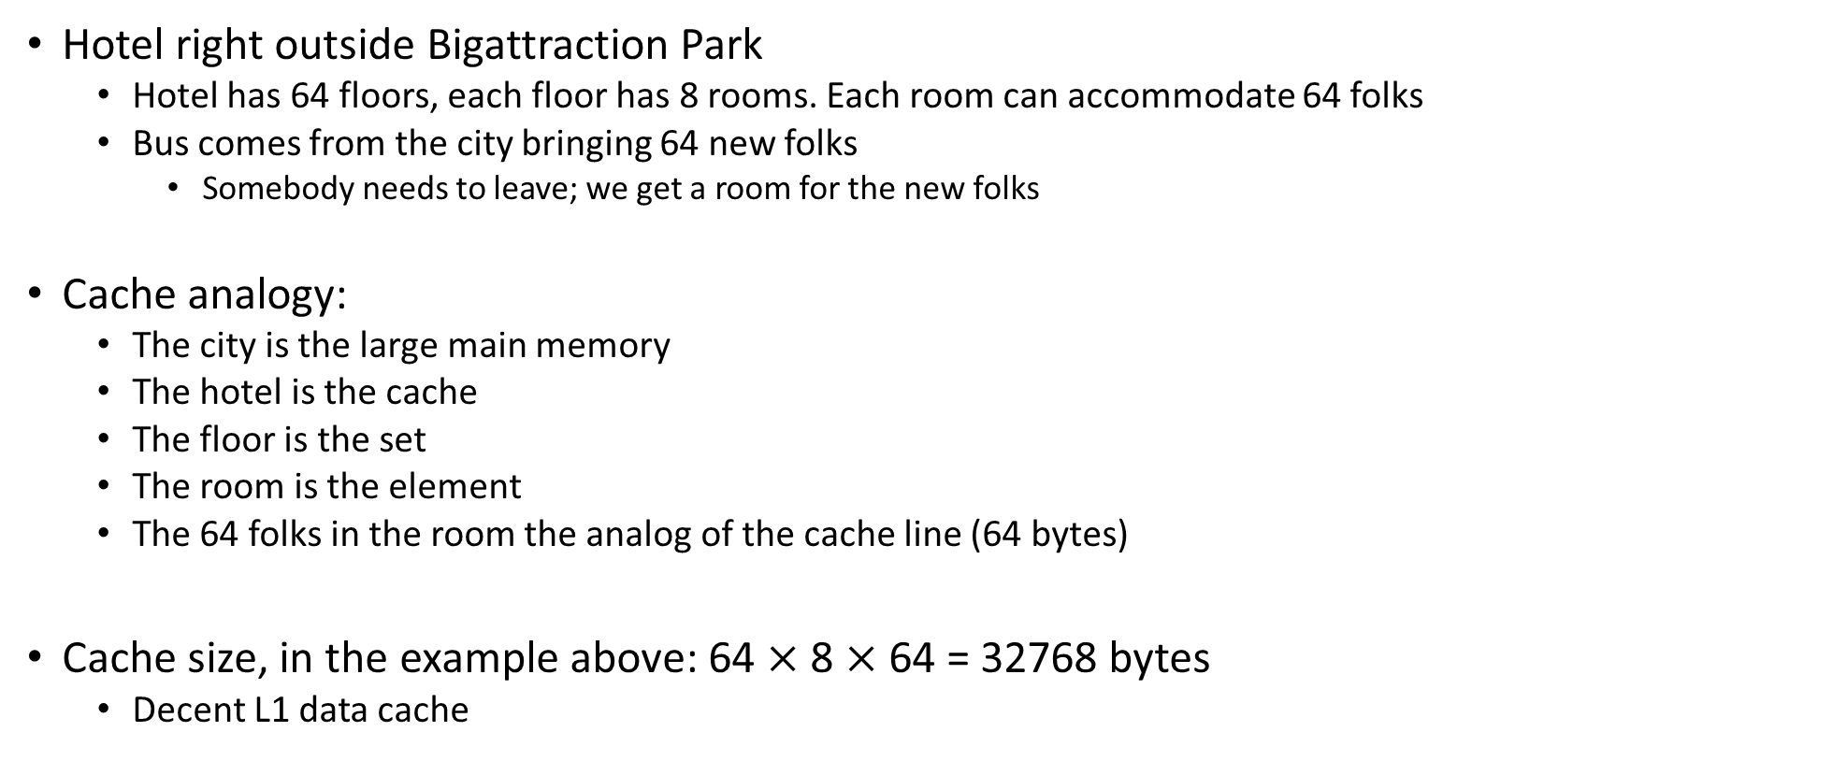
Caches, and the hotel analogy
Hotel right outside Bigattraction Park
Hotel has 64 floors, each floor has 8 rooms. Each room can accommodate 64 folks
Bus comes from the city bringing 64 new folks
Somebody needs to leave; we get a room for the new folks
Cache analogy:
The city is the large main memory
The hotel is the cache
The floor is the set
The room is the element
The 64 folks in the room the analog of the cache line (64 bytes)
Cache size, in the example above: 64 $×$ 8 $×$ 64 = 32768 bytes
Decent L1 data cache

Slide 5
Placement & Replacement Policies
The cache is small, while the memory that you try to cache in this cache is large
The cache: prime real estate – when somebody comes in, somebody else has to be evicted
Caching: like bringing folks from a city to live in one apartment building next to some prime attraction
“prime attraction”: the registers and the ALU/CU
placement policy: deciding in which “apartment in the building” to drop the cache line
Sometimes, there are several rooms in an apartment: which one do you assign to the new folks?
“replacement policy” – if you have Option A and Option B, which one should you choose: A or B?
You’ll kick out tenant from room A, or tenant from room B

Slide 6
Placement Policies
Policies that are common:
“When you bring a line of cache…”
You are free to place wherever (fully associative cache)
Based on the main memory address of the data, you can put it in one of 4 places (four rooms in an apartment)
Or 2 places, 8 places, or k places (for k-way associative cache)
You can only put it in one place (direct mapped cache)

Slide 7
Placement Policies: further discussion
Fully associative
Pros: you have full control which old cache line you want to kick out (you have a very flexible replacement policy)
Cons:
Higher overhead to find what you’re looking for (data can be anywhere in cache)
Higher overhead to decide whom to evict (the “victim”)
Direct mapped
Pros: very fast to find if in cache or not
Cons: might have to evict a line cache that actually sees a lot of use (no freedom at all in replacement policy)
K-way associative
Decent compromise; i.e., it yields a reasonably decent replacement policy – you have K options to choose from
Intel and AMD chips: 2, 4, 8, 16-way associative
Depends on cache level and which chip model

Slide 8
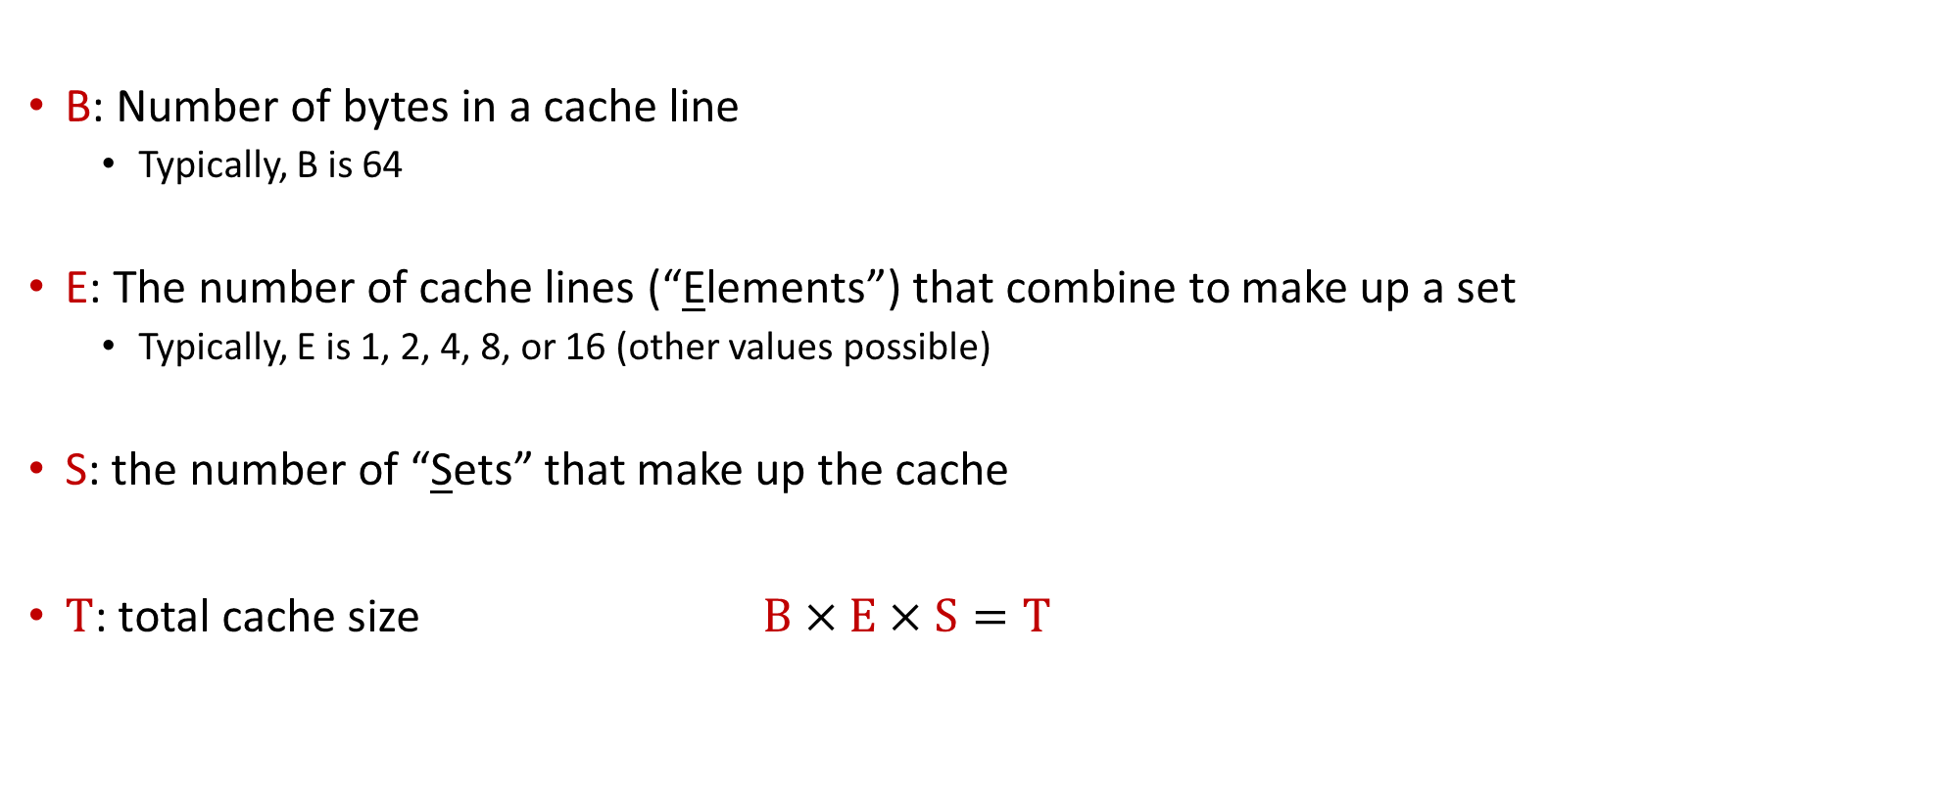
[New Topic:] General Cache Organization [Symbols Used and Their Meaning]
B: Number of bytes in a cache line
Typically, B is 64
E: The number of cache lines (“Elements”) that combine to make up a set
Typically, E is 1, 2, 4, 8, or 16 (other values possible)
S: the number of “Sets” that make up the cache
$T$: total cache size $B×E×S=T$

Slide 9
General Cache Organization (B, E, S)
E = 2e lines per set
a “cache Set”
a “cache Element” (it wraps inside a cache line; an element belongs to a set)
S = 2^{s} sets
Cache size:
B x E x S=T data bytes
How a “cache Element” is organized
v
tag
0
1
2
B-1
valid bit
B = 2^{b} bytes of data per cache block (cache line)
[Bryant and O‘Hallaron: CMU] →

Slide 10
On finding if data from a main memory address is in cache
The mission: Read into register a variable at a given memory address
The important question: Is the value stored at this address by any chance in cache?
To answer this question, the addressed is partitioned in three chunks
Memory address (either 32 or 64 bits)
t bits
s bits
b bits
tag
set
index
block
offset

Slide 11
The key ingredient is the set index
The set index give me “the floor in the hotel where I should look for Joe who lives at 12 Main St.
The s bits of the address
Hotel must have 2^{s} floors
Important remark: there are many addresses in main memory that will have the same set index
Translation: folks from many neighborhoods of the town assigned to the same hotel floor
Memory address (either 32 or 64 bits)
t bits
s bits
b bits
tag
set
index
block
offset

Slide 12
How Cache Read Takes Place
E = 2e lines per set
Memory address (either 32 or 64 bits):
t bits
s bits
b bits
S = 2^{s} sets
tag
set
index
block
offset
data begins at this offset
How the game is played:
v
tag
0
1
2
B-1
Locate set
Check if any element in set has matching tag
Yes + line valid = hit
Locate data starting at offset
valid bit
B = 2^{b} bytes – the cache block (the data)
[Bryant and O‘Hallaron: Computer Systems - A Programmer's Perspective 3rd edition] →

Slide 13
Example: Direct Mapped Cache (E = 1)
Direct mapped: One line per set
Assume: cache block size 8 bytes (instead of 64)
Address of int:
v
tag
0
1
2
3
4
5
6
7
t bits
0…01
100
v
tag
0
1
2
3
4
5
6
7
find set
S = 2^{s} sets
v
tag
0
1
2
3
4
5
6
7
v
tag
0
1
2
3
4
5
6
7
[Bryant and O‘Hallaron: CMU] →

Slide 14
Example: Direct Mapped Cache (E = 1)
Direct mapped: One line per set
Assume: cache block size 8 bytes (instead of 64)
Address of int:
valid? +
match: assume yes = hit
t bits
0…01
100
v
tag
0
1
2
3
4
5
6
7
tag
block offset
[Bryant and O‘Hallaron: CMU] →

Slide 15
Example: Direct Mapped Cache (E = 1)
Direct mapped: One line per set
Assume: cache block size 8 bytes (instead of 64)
Address of int:
valid? +
match: assume yes = hit
t bits
0…01
100
v
tag
0
1
2
3
4
5
6
7
block offset
int (4 Bytes) that you care about is here
If tag doesn’t match: old line is evicted and replaced
[Bryant and O‘Hallaron: CMU] →

Slide 16
E-way Set Associative Cache (Here: E = 2)
E = 2: Two elements/lines per set
Assume: cache block size 8 bytes (instead of 64)
Address of short int:
2 elements per set
t bits
0…01
100
v
tag
0
1
2
3
4
5
6
7
v
tag
0
1
2
3
4
5
6
7
v
tag
0
1
2
3
4
5
6
7
v
tag
0
1
2
3
4
5
6
7
find set
v
tag
0
1
2
3
4
5
6
7
v
tag
0
1
2
3
4
5
6
7
v
tag
0
1
2
3
4
5
6
7
v
tag
0
1
2
3
4
5
6
7
S sets
[Bryant and O‘Hallaron: CMU] →

Slide 17
E-way Set Associative Cache (Here: E = 2)
E = 2: Two elements/lines per set
Assume: cache block size 8 bytes (instead of 64)
Address of short int:
compare both
t bits
0…01
100
valid? +
match: yes = hit
v
tag
0
1
2
3
4
5
6
7
tag
v
tag
0
1
2
3
4
5
6
7
block offset
[Bryant and O‘Hallaron: CMU] →

Slide 18
E-way Set Associative Cache (Here: E = 2)
E = 2: Two elements/lines per set
Assume: cache block size 8 bytes (instead of 64)
Address of short int:
compare both
t bits
0…01
100
valid? +
match: yes = hit
v
tag
0
1
2
3
4
5
6
7
v
tag
0
1
2
3
4
5
6
7
block offset
short int (2 Bytes) is here
No match:
One line in set is selected for eviction and replacement
Replacement policies: random, least recently used (LRU), …
[Bryant and O‘Hallaron: CMU] →

Slide 19
Quiz: How many neighborhoods sent folks to same hotel floor?
There are many addresses in main memory that will have the same set index
Translation: folks from many neighborhoods of the town assigned to the same hotel floor
Assume 32 bit OS, and the set index is 6 bits wide (64 sets)
How many “neighborhoods” of the main memory send folks to the same floor of the hotel?
How is associativity helping?
Memory address (either 32 or 64 bits)
t bits
s bits
b bits
tag
set
index
block
offset
Notes:
6 bits for cache line + 6 bits for set index: 12 bits.
32-12=20.
Therefore, there are 2^20, about 4 million neighborhoods that send folks to the same floor of the hotel.
Having K-way associativity saves eviction

Slide 20
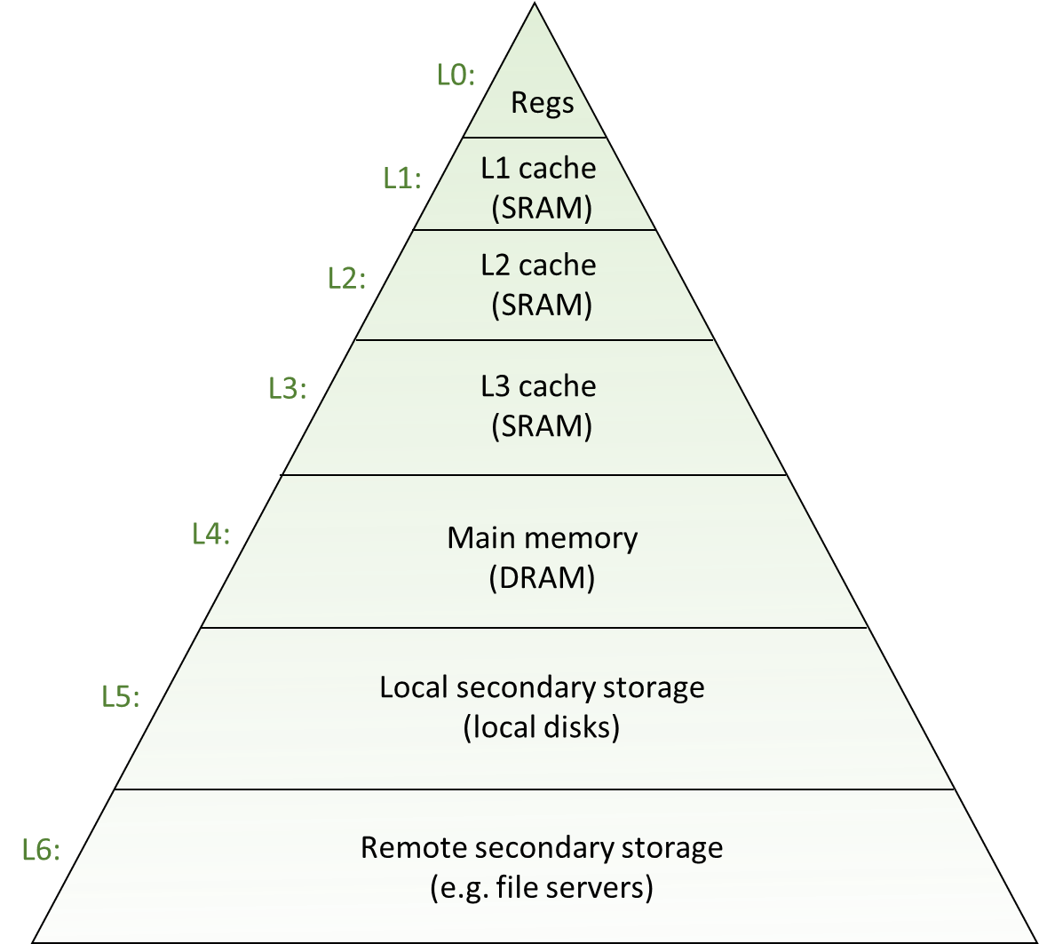
Why these acrobatics?
Trying to fit a lot of memory (system memory, GBs of it) into little memory (cache, MBs of it)
Common sense: you have to use tricks to accommodate stuff from a big pot into a small pot
This dilemma of storing a lot of information in a small space is pervasive
Because of the memory hierarchy reality we are operating under
Similar tricks for placing data in main memory relative to placing in secondary memory

Slide 21
Going on a tangent: TLP vs ILP
Chip can do more than one instruction per cycle
ILP flavor: if chip is superscalar, more than one instruction can be wrapped up/clock cycle
TLP flavor: two threads/processes run at same time, say A and B
Cache implications: TLP at a disadvantage
On each miss by B, the cache victimizes an approximation of the least-recently-used (LRU) cache block
Most of B’s misses will victimize blocks last accessed by A rather than last accessed by itself
Consequences:
The L1 cache turns over sufficiently fast that you can approximately assume that B victimizes all of A’s blocks
Whether L2 cache is completely flushed depends on B’s rate of misses, the L2 size, and how long B runs

Slide 22
The Caching Landscape in the Memory Hierarchy
Cache Type
What is Cached?
Where is it Cached?
Latency (cycles)
Managed By
Registers
4-8 bytes words
CPU core
0
Compiler/CU
TLB
Address translations
On-Chip TLB
0
Hardware MMU
L1 cache
64-byte blocks
On-Chip L1
4
Hardware
L2 cache
64-byte blocks
On-Chip L2
10
Hardware
Virtual Memory
4-KB pages
Main memory
100
Hardware + OS
Buffer cache
Parts of files
Main memory
100
OS
Disk cache
Disk sectors
Disk controller
100,000
Disk firmware
Network buffer cache
Parts of files
Local disk
10,000,000
NFS client
Browser cache
Web pages
Local disk
10,000,000
Web browser
Web cache
Web pages
Remote server disks
1,000,000,000
Web proxy server

Slide 23
Example [using CAE’s tux-103]
>> less /proc/cpuinfo
processor : 0
vendor_id : GenuineIntel
cpu family : 6
model : 60
model name : Intel(R) Core(TM) i5-4570 CPU @ 3.20GHz
stepping : 3
microcode : 0x20
cpu MHz : 3197.500
cache size : 6144 KB
physical id : 0
siblings : 4
core id : 0
cpu cores : 4
apicid : 0
fpu : yes
fpu_exception : yes
cache_alignment : 64
address sizes : 39 bits physical, 48 bits virtual
Cache line size: 64 bytes → 2^6 Bytes
8-way associative → 2^3
Amount of memory: 256KB → 2^18 Bytes
Number of sets: 2^18/(2^6*2^3)=2^9=512
>> grep . /sys/devices/system/cpu/cpu0/cache/index*/*
/sys/devices/system/cpu/cpu0/cache/index2/coherency_line_size:64
/sys/devices/system/cpu/cpu0/cache/index2/level:2
/sys/devices/system/cpu/cpu0/cache/index2/number_of_sets:512
/sys/devices/system/cpu/cpu0/cache/index2/physical_line_partition:1
/sys/devices/system/cpu/cpu0/cache/index2/size:256K
/sys/devices/system/cpu/cpu0/cache/index2/type: Unified
/sys/devices/system/cpu/cpu0/cache/index2/ways_of_associativity:8

Slide 24
Revisiting an old slide [hopefully it makes better sense now]
Processor package
Core 0
Core 3
L1 i-cache and d-cache:
32 KB, 8-way,
Access: 4 cycles
L2 unified cache:
256 KB, 8-way,
Access: 10 cycles
L3 unified cache:
8 MB, 16-way,
Access: 20-30 cycles
Block size: 64 bytes for all caches.
Registers
Registers
L1
d-cache
L1
i-cache
L1
d-cache
L1
i-cache
…
L2 unified cache
L2 unified cache
L3 unified cache
(shared by all cores)
Main memory
[Bryant and O‘Hallaron: CMU] →

Slide 25
We’ve done memory reads. What about writes?
Multiple copies of data exist stored in different places and at the same time:
L1, L2, L3, Main Memory, Secondary Memory (Disk)
How should a write-hit be handled?
Write-through (write immediately to main memory as well)
Write-back (defer write to main memory until replacement of line)
Need a dirty bit (indicate whether line different from memory or not)
How should a write-miss be handled?
Write-allocate (load into cache, update line in cache)
Good if more writes to the location follow; i.e., if locality is good
No-write-allocate (writes straight to memory, does not load into cache)
Typical combos met in practice:
Write-back + Write-allocate ← more common
Write-through + No-write-allocate

Slide 26
Cache performance metrics [a nomenclature matter]
Miss Rate
Defined as Miss Rate = 1 – Hit Rate (note that we defined the Hit Rate in the previous lecture)
Represents the fraction of memory references that are not found in cache
Typical numbers (in percentages):
As low as 3-10% for L1
Can be quite small (e.g., < 1%) for L2, depending on size, nature of problem you run, etc.
Hit Time
Time to deliver a line in the cache into a register of the processor
Includes time to determine whether the line is in the cache
Typical numbers:
4 clock cycle for L1
10 clock cycles for L2
Miss Penalty
Additional time required because of a miss
Typically 50-200 cycles for main memory (Trend: slightly increasing)
[Bryant and O‘Hallaron: CMU] →

Slide 27
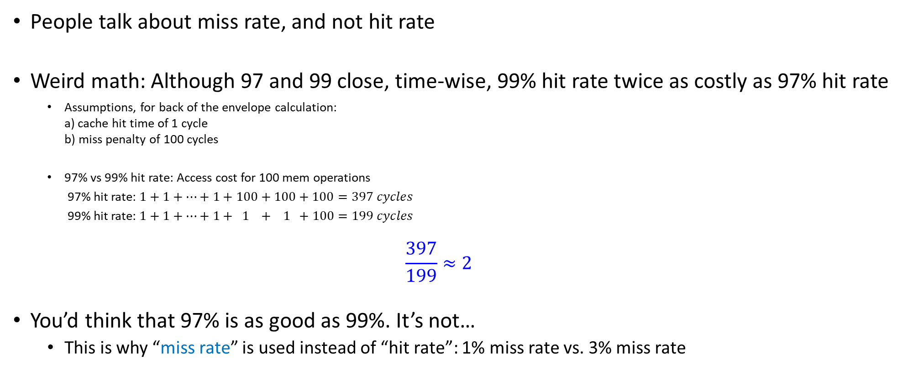
People Talk Miss Rate, Not Hit Rate
People talk about miss rate, and not hit rate
Weird math: Although 97 and 99 close, time-wise, 99% hit rate twice as costly as 97% hit rate
Assumptions, for back of the envelope calculation: a) cache hit time of 1 cycle b) miss penalty of 100 cycles
97% vs 99% hit rate: Access cost for 100 mem operations
97% hit rate: $1+1+…+1+100+100+100=397 cycles$
99% hit rate: $1+1+…+1+ 1 + 1 +100=199 cycles$
$$\frac{397}{199}≈2$$
You’d think that 97% is as good as 99%. It’s not…
This is why “miss rate” is used instead of “hit rate”: 1% miss rate vs. 3% miss rate
[Bryant and O‘Hallaron: CMU] →

Slide 28
Writing Cache Friendly Code: Rules of Thumb (more to come)
Basic facts:
You have no *direct* control over what data gets cached
However, you are not helpless: ensure your code is “local” (spatially and/or temporally)
when you write code, do not violate locality, if at all possible

Slide 29
Other performance rule of thumb
Make the common case go fast
Focus on the inner loops of the “heavy” functions
Try to have cache-friendly code in the inner loops
Repeated references to same variables are good (temporal locality)
“stride of one” reference patterns are good (spatial locality)
[Bryant and O‘Hallaron: CMU] →

Slide 30
Approaching the task of programming
By and large, people write code by paying attention to
Correctness
Esthetics of the solution developed
Objects, lists, patterns, inheritance, etc. – code is flexible and easy to maintain
Portability
Data Analytics (Big Data): you should think about performance when writing/designing software
Cache friendly code via “locality” is king
When you write a line of code, always pause and ask yourself: where is this data that I’m referencing here comes from?
Departing thoughts:
Does “performance” come before “esthetics”? Or “portability”?
Good read: “The Mythical Man-Month,” by Frederick Phillips Brooks Jr.

Slide 31
The “Memory Mountain” Experiment
Task at hand in this exercise: adding up numbers in an array (just like example of two lectures ago)
The numbers must be brought over into the chip to be added
Timing how long it takes to finish execution: a good proxy for speed of moving data
Why?
Because the math is trivial, eats up no time at all: sum = sum + a[i]
Moral of the story: the good cases are the ones with very high “effective bandwidth”
“effective bandwidth”: computed by dividing amount of data moved during solving problem to the amount of time required to finish the execution

Slide 32
Memory Mountain Test Function
void test(double* data, int elems, int stride) /* The test function */
{
int i;
double result = 0.0;
volatile double sink;
for (i = 0; i < elems; i += stride) {
result += data[i];
}
sink = result; /* So compiler doesn't optimize away the loop */
}
2010 Vintage
Call test() with many combinations of elems and stride.
For each elems and stride:
1. Call test() once to warm up the caches ($←$important!!!)
2. Call test() again and measure the read throughput (MB/s)
NOTE: the “volatile” qualifier used to not optimize away the accumulator
void test(long *data, long elems, long stride)
{
volatile long accum = 0;
long i, sx2 = stride * 2, sx3 = stride * 3, sx4 = stride * 4;
long acc0 = 0, acc1 = 0, acc2 = 0, acc3 = 0;
long length = elems;
long limit = length - sx4;
/* Combine 4 elements at a time */
for (i = 0; i < limit; i += sx4) {
acc0 = acc0 + data[i];
acc1 = acc1 + data[i + stride];
acc2 = acc2 + data[i + sx2];
acc3 = acc3 + data[i + sx3];
}
/* Finish any remaining elements */
for (; i < length; i += stride) {
acc0 = acc0 + data[i];
}
accum = ((acc0 + acc1) + (acc2 + acc3));
}
2016 Vintage
[http://www.cs.cmu.edu/afs/cs/academic/class/15213-f10/www/code/10-cache-memories/mountain/]→
[http://www.cs.cmu.edu/afs/cs/academic/class/15213-f16/www/code/10-cache-memories/mountain/]→

Slide 33
The Memory Mountain [2008]
Core 2 Duo
2.4 GHz
32 KB L1 d-cache
6MB L2 cache
64 B block size
L1
Ridges
of temporal locality
L2
Mem

Slide 34
The Memory Mountain [2014]
Aggressive prefetching
Core i5 Haswell
3.1 GHz
32 KB L1 d-cache
256 KB L2 cache
8 MB L3 cache
64 B block size
L1
Ridges
of temporal locality
L2
L3
Slopes
of spatial locality
Mem
[Bryant and O‘Hallaron: CMU] →

Slide 35
Cache Capacity Effects from Memory Mountain
Main Memory
L3
L2
L1
Core i7 Haswell
3.1 GHz
32 KB L1 Data Cache
256 KB L2 Cache
8 MB L3 Cache
64 B block size
Slice through memory mountain with stride=8
[Bryant and O‘Hallaron: CMU] →

Slide 36
The “Memory Mountain” experiment: closing thoughts
Read throughput (read bandwidth)
Number of bytes read from main memory per second (MB/s)
Memory mountain: Measures read-throughput as a function of spatial and temporal locality
Compact way to characterize memory system performance
[Bryant and O‘Hallaron: CMU] →

Slide 37
New Topic: Virtual Memory

Slide 38
Why talk about “Virtual Memory”?
Understand how memory transactions take place, and why some incur higher overhead
Add more credibility to some key points of this course, e.g.,
Number crunching is inexpensive
Moving infromation back and forth is expensive
Both in terms of time & power

Slide 39
Why talk about “Virtual Memory”?
“Virtual Memory” discussion:
It will help you understand how unlucky your memory transactions can become in some cases
E.g.: page faults, memory thrashing :-(
It’ll make you appreciate caches even more
They serve multiple purposes, e.g., help with: data storage, instruction storage, finding things in main memory (address translation)
It helps one understand how unified memory works for GPU computing (discussed later on, after GPU computing segment)
Notes:
DN: nice summary of page faults vs thrashing is here - https://stackoverflow.com/questions/19031902/what-is-thrashing-why-does-it-occur

